Slide 1
Able to develop the real time scenarios based on Node JS applications.
Notes:
Title - The learning outcome
Subtitle - Duration

Slide 2
In this section, we will discuss:
Angular JS Pipe
Angular js Routing
Angular js Services
Angular js Http Request
Node Introduction
Blocking & Nonblocking code
Notes:
Mention the parent topics one by one. This particular learning outcome has 4 parent topics.

Slide 3
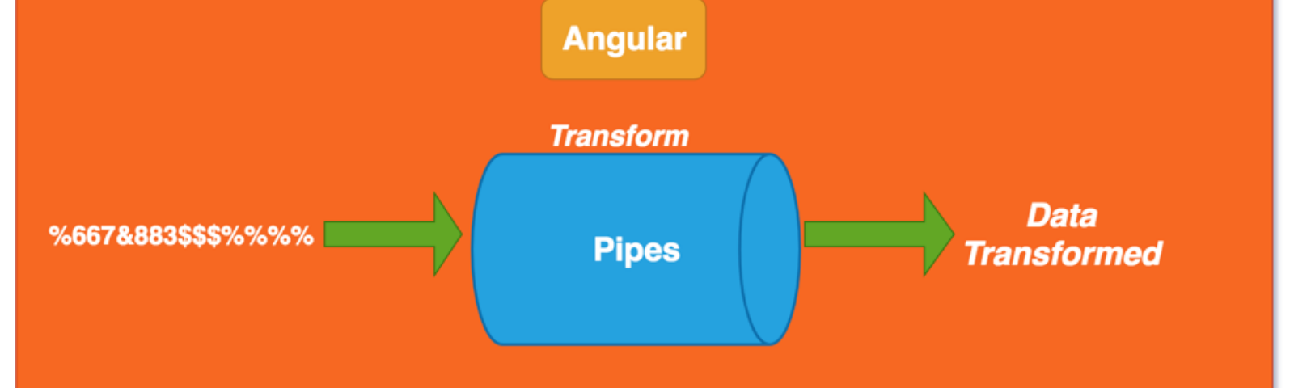
Angular JS Pipe
What is Pipe?
The pipe symbol (|) is used for applying filters in AngularJS. A filter is a function that is invoked for handling model transformations.
Its basically just a global function that doesn't require registration of functions on a scope, and offers more convenient syntax to regular function calls.
Image Source:https://cdn-images-1.medium.com/fit/t/1600/480/1*q8_BX2R8hPe8BpkvPOWgEQ.png
Notes:
Left (White Color space):
Title - Parent Topic
Subtitle - Subtopic 1
Body Text - Description in bullets
Right (Grey Color Space):
Body Text - Relevant image (with source)/code snippet
Put reference links in Speaker Notes
Reference:
https://www.tutorialspoint.com/internet_technologies/internet_overview.htm/

Slide 4
Angular JS Pipe
What is Pipe?
A pipe class must implement the PipeTransform interface.
A pipe must belong to an NgModule in order for it to be available to a template.
Angular Pipes are used to transform data on a template, without writing a boilerplate code in a component.
Image Source: https://cdn-images-1.medium.com/fit/t/1600/480/1*q8_BX2R8hPe8BpkvPOWgEQ.png
Notes:
Left (White Color space):
Title - Parent Topic
Subtitle - Subtopic 1
Body Text - Description in bullets
Right (Grey Color Space):
Body Text - Relevant image (with source)/code snippet
Put reference links in Speaker Notes
Reference:
https://www.tutorialspoint.com/internet_technologies/internet_overview.htm/

Slide 5
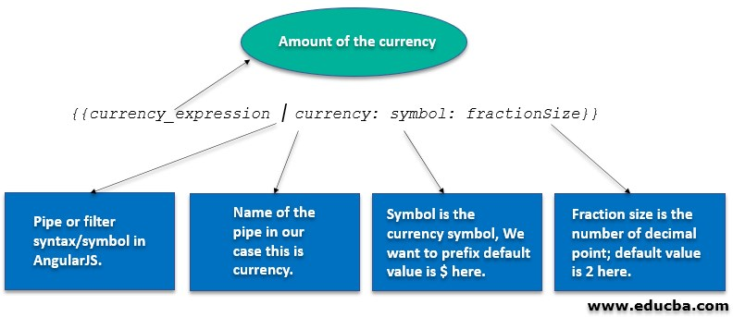
Angular JS Pipe
Why Pipe?
A pipe takes in data as input and transforms it to the desired output. It is like a filter in Angular 1 (AngularJS).
We can use the pipe on a template using Pipe Operator | .As shown below,
{{today | date : ‘fullDate’}}
Image Source: https://cdn.educba.com/academy/wp-content/uploads/2020/03/JavaScript-References-lll.jpg
Notes:
Left (White Color space):
Title - Parent Topic
Subtitle - Subtopic 1
Body Text - Description in bullets
Right (Grey Color Space):
Body Text - Relevant image (with source)/code snippet
Put reference links in Speaker Notes
Reference:
https://www.tutorialspoint.com/internet_technologies/internet_overview.htm/

Slide 6
Angular JS Pipe
Why Pipe?
here,
today is the component variable, which specifies the current date.
date represent DataPipe
fullDate is an optional parameter or argument which specifies the date format.
Image Source: https://cdn.educba.com/academy/wp-content/uploads/2020/03/JavaScript-References-lll.jpg
Notes:
Left (White Color space):
Title - Parent Topic
Subtitle - Subtopic 1
Body Text - Description in bullets
Right (Grey Color Space):
Body Text - Relevant image (with source)/code snippet
Put reference links in Speaker Notes
Reference:
https://www.tutorialspoint.com/internet_technologies/internet_overview.htm/

Slide 7
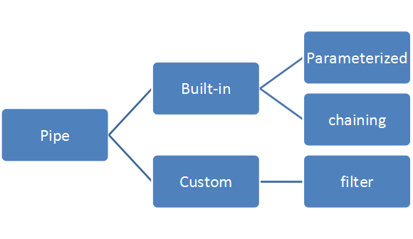
Angular JS Pipe
Types of Pipe
There are two types of Pipe:
Build-In Pipe
Custom Pipe
Image Source: https://miro.medium.com/max/580/1*znGD7VrQ6nlZkAOsuPmJDg.png
Notes:
Left (White Color space):
Title - Parent Topic
Subtitle - Subtopic 1
Body Text - Description in bullets
Right (Grey Color Space):
Body Text - Relevant image (with source)/code snippet
Put reference links in Speaker Notes
Reference:
https://www.tutorialspoint.com/internet_technologies/internet_overview.htm/

Slide 8
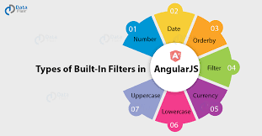
Angular JS Pipe
Built-In Pipes
Angular comes with a collection of built-in pipes such as:
DatePipe
UpperCasePipe
LowerCasePipe
CurrencyPipe
DecimalPipe
PercentPipe
Image Source: https://miro.medium.com/max/1400/1*lVD2Qe8zAD3qnXHRj-dI1w.png
Notes:
Left (White Color space):
Title - Parent Topic
Subtitle - Subtopic 1
Body Text - Description in bullets
Right (Grey Color Space):
Body Text - Relevant image (with source)/code snippet
Put reference links in Speaker Notes
Reference:
https://www.tutorialspoint.com/internet_technologies/internet_overview.htm/

Slide 9
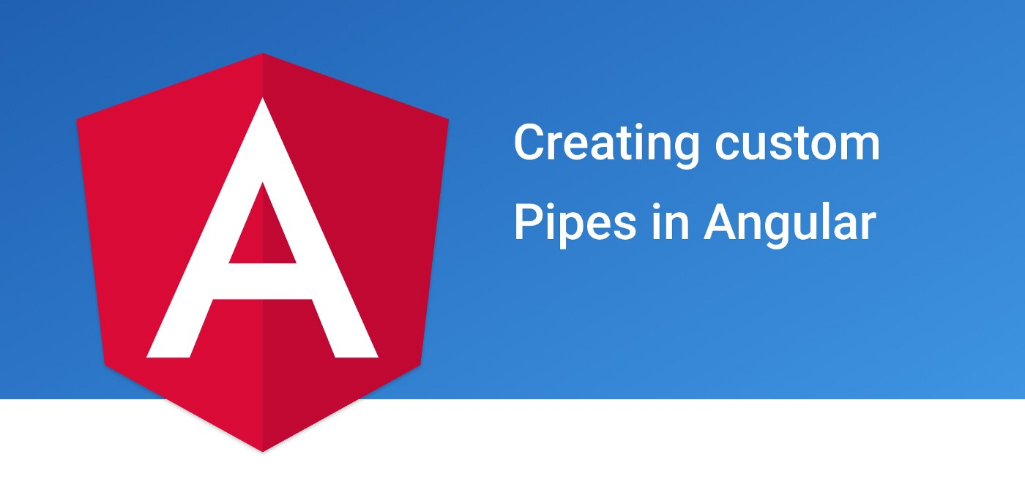
Angular JS Pipe
Custom Pipe
Custom Pipes can be of two types. Pure and impure custom pipe. Pipe takes an input and returns an output based on the output of transform function evaluation.
Image Source: https://miro.medium.com/max/1400/1*PVzEV4fnMji3JF-MpPhduA.jpeg
Notes:
Left (White Color space):
Title - Parent Topic
Subtitle - Subtopic 1
Body Text - Description in bullets
Right (Grey Color Space):
Body Text - Relevant image (with source)/code snippet
Put reference links in Speaker Notes
Reference:
https://www.tutorialspoint.com/internet_technologies/internet_overview.htm/

Slide 10
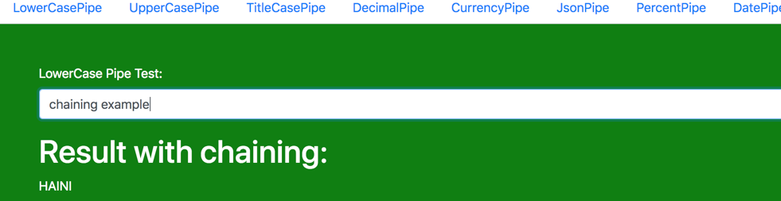
Pipe Chaining
What Is Pipe Channing?
The chaining Pipe is used to perform the multiple operations within the single expression. This chaining operation will be chained using the pipe (I).
Image Source: https://miro.medium.com/max/1400/1*JfjKPYK3qWE2bmVjQNIupg.png
Notes:
Left (White Color space):
Title - Parent Topic
Subtitle - Subtopic 1
Body Text - Description in bullets
Right (Grey Color Space):
Body Text - Relevant image (with source)/code snippet
Put reference links in Speaker Notes
Reference:
https://www.tutorialspoint.com/internet_technologies/internet_overview.htm/

Slide 11

Pipe Chaining
What Is Parameterizing Pipe?
A pipe can accept any number of optional parameters to achieve output. The parameter value can be any valid template expressions. To add optional parameters follow the pipe name with a colon (:). Its looks like- currency: 'INR'
Image Source: https://miro.medium.com/max/1400/1*JfjKPYK3qWE2bmVjQNIupg.png
Notes:
Left (White Color space):
Title - Parent Topic
Subtitle - Subtopic 1
Body Text - Description in bullets
Right (Grey Color Space):
Body Text - Relevant image (with source)/code snippet
Put reference links in Speaker Notes
Reference:
https://www.tutorialspoint.com/internet_technologies/internet_overview.htm/

Slide 12
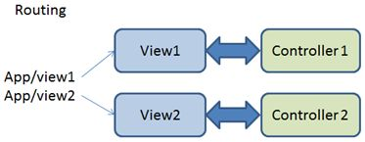
Angular js Routing
What Is Angular js Routing
Routing is a core feature in AngularJS. This feature is useful in building SPA (Single Page Application) with multiple views.
In SPA application, all views are different Html files and we use Routing to load different part of application and its help to divide application logically and make it manageable.
Image Source: https://csharpcorner-mindcrackerinc.netdna-ssl.com/UploadFile/ff2f08/routing-in-angularjs/Images/Routing.jpg
Notes:
Left (White Color space):
Title - Parent Topic
Subtitle - Subtopic 1
Body Text - Description in bullets
Right (Grey Color Space):
Body Text - Relevant image (with source)/code snippet
Put reference links in Speaker Notes
Reference:
https://www.tutorialspoint.com/internet_technologies/internet_overview.htm/

Slide 13
Angular js Routing
Introduction to ngRoute Module
This module provides routing in AngularJS application and also provides deep linking services and directives. To achieve routing in AngularJS, we need to include the library file of ngRoute.
Image Source: https://csharpcorner-mindcrackerinc.netdna-ssl.com/UploadFile/ff2f08/routing-in-angularjs/Images/Routing.jpg
Notes:
Left (White Color space):
Title - Parent Topic
Subtitle - Subtopic 1
Body Text - Description in bullets
Right (Grey Color Space):
Body Text - Relevant image (with source)/code snippet
Put reference links in Speaker Notes
Reference:
https://www.tutorialspoint.com/internet_technologies/internet_overview.htm/

Slide 14
Angular js Routing
Component of ngRoute Module
There are four main components of ngRoute module:
ngView
$routeProvider
$route
$routeParams
Image Source: https://csharpcorner-mindcrackerinc.netdna-ssl.com/UploadFile/ff2f08/routing-in-angularjs/Images/Routing.jpg
Notes:
Left (White Color space):
Title - Parent Topic
Subtitle - Subtopic 1
Body Text - Description in bullets
Right (Grey Color Space):
Body Text - Relevant image (with source)/code snippet
Put reference links in Speaker Notes
Reference:
https://www.tutorialspoint.com/internet_technologies/internet_overview.htm/

Slide 15
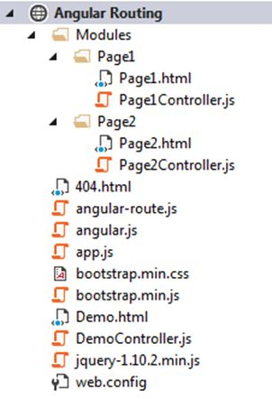
Angular js Routing
Hello World Example
Routing in AngularJS is used to load different templates at runtime. In the following example we will elaborate it more step by step.
Step 1: Create basic structure of application (SPA).
Image Source: https://csharpcorner-mindcrackerinc.netdna-ssl.com/UploadFile/ff2f08/routing-in-angularjs/Images/Project%20structure.jpg
Notes:
Left (White Color space):
Title - Parent Topic
Subtitle - Subtopic 1
Body Text - Description in bullets
Right (Grey Color Space):
Body Text - Relevant image (with source)/code snippet
Put reference links in Speaker Notes
Reference:
https://www.tutorialspoint.com/internet_technologies/internet_overview.htm/

Slide 16
Angular js Routing
Hello World Example
Step 2: Add Routing
Step 3: Define HTML Template and controller
Image Source: https://csharpcorner-mindcrackerinc.netdna-ssl.com/UploadFile/ff2f08/routing-in-angularjs/Images/Project%20structure.jpg
Notes:
Left (White Color space):
Title - Parent Topic
Subtitle - Subtopic 1
Body Text - Description in bullets
Right (Grey Color Space):
Body Text - Relevant image (with source)/code snippet
Put reference links in Speaker Notes
Reference:
https://www.tutorialspoint.com/internet_technologies/internet_overview.htm/

Slide 17
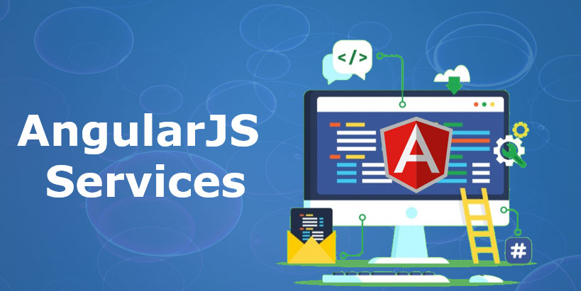
Angular js Services
What are AngularJS Services?
AngularJs service is a function, which can use for the business layer of an application. It is like a constructor function that will invoke only once at runtime with new.
Services in AngularJS are stateless and singleton objects .
Image Source: https://cdn.educba.com/academy/wp-content/uploads/2020/01/angular-js-service.jpg
Notes:
Left (White Color space):
Title - Parent Topic
Subtitle - Subtopic 1
Body Text - Description in bullets
Right (Grey Color Space):
Body Text - Relevant image (with source)/code snippet
Put reference links in Speaker Notes
Reference:
https://www.tutorialspoint.com/internet_technologies/internet_overview.htm/

Slide 18
Angular js Services
When to use Services in AngularJS?
We can use AngularJS services when we want to create things that act as an application interface. It can be used for all those purposes for which constructor is used.
Image Source: https://cdn.educba.com/academy/wp-content/uploads/2020/01/angular-js-service.jpg
Notes:
Left (White Color space):
Title - Parent Topic
Subtitle - Subtopic 1
Body Text - Description in bullets
Right (Grey Color Space):
Body Text - Relevant image (with source)/code snippet
Put reference links in Speaker Notes
Reference:
https://www.tutorialspoint.com/internet_technologies/internet_overview.htm/

Slide 19
Angular js Services
Types of AngularJS Services
There are two types of services in angular:
Built-in services
Custom services
Image Source: https://cdn.educba.com/academy/wp-content/uploads/2020/01/angular-js-service.jpg
Notes:
Left (White Color space):
Title - Parent Topic
Subtitle - Subtopic 1
Body Text - Description in bullets
Right (Grey Color Space):
Body Text - Relevant image (with source)/code snippet
Put reference links in Speaker Notes
Reference:
https://www.tutorialspoint.com/internet_technologies/internet_overview.htm/

Slide 20
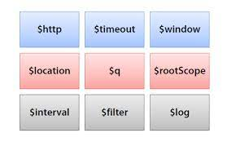
Angular js Services
Built-in Services in AngularJS
They are pre-built services in AngularJS. These services get registered automatically at runtime with the dependency injector.
$http
$interval
$timeout
$anchorscroll
Image Source: https://encrypted-tbn0.gstatic.com/images?q=tbn:ANd9GcQZi-_-a-7v-_r6WA-Ly23zsC8XW51Rww4fLFMnd2w2E8cZdxJ6iUtoxHKHPsdWwVCTXnY&usqp=CAU
Notes:
Left (White Color space):
Title - Parent Topic
Subtitle - Subtopic 1
Body Text - Description in bullets
Right (Grey Color Space):
Body Text - Relevant image (with source)/code snippet
Put reference links in Speaker Notes
Reference:
https://www.tutorialspoint.com/internet_technologies/internet_overview.htm/

Slide 21
Angular js Services
Built-in Services in AngularJS
$animate
$animateCss
$cacheFactory
$templateCache
$compile
$controller
$document:
Image Source: https://encrypted-tbn0.gstatic.com/images?q=tbn:ANd9GcQZi-_-a-7v-_r6WA-Ly23zsC8XW51Rww4fLFMnd2w2E8cZdxJ6iUtoxHKHPsdWwVCTXnY&usqp=CAU
Notes:
Left (White Color space):
Title - Parent Topic
Subtitle - Subtopic 1
Body Text - Description in bullets
Right (Grey Color Space):
Body Text - Relevant image (with source)/code snippet
Put reference links in Speaker Notes
Reference:
https://www.tutorialspoint.com/internet_technologies/internet_overview.htm/

Slide 22
Angular js Services
Built-in Services in AngularJS
$exceptionHandler
$filter
$httpParamSerializer
$httpParamSerializerJQLike
$xhrFactory
$httpBackendx
Image Source: https://encrypted-tbn0.gstatic.com/images?q=tbn:ANd9GcQZi-_-a-7v-_r6WA-Ly23zsC8XW51Rww4fLFMnd2w2E8cZdxJ6iUtoxHKHPsdWwVCTXnY&usqp=CAU
Notes:
Left (White Color space):
Title - Parent Topic
Subtitle - Subtopic 1
Body Text - Description in bullets
Right (Grey Color Space):
Body Text - Relevant image (with source)/code snippet
Put reference links in Speaker Notes
Reference:
https://www.tutorialspoint.com/internet_technologies/internet_overview.htm/

Slide 23
Angular js Services
Built-in Services in AngularJS
$interpolate
$locale
$location
$logiv
$rootElement
$sceDelegate
Image Source: https://encrypted-tbn0.gstatic.com/images?q=tbn:ANd9GcQZi-_-a-7v-_r6WA-Ly23zsC8XW51Rww4fLFMnd2w2E8cZdxJ6iUtoxHKHPsdWwVCTXnY&usqp=CAU
Notes:
Left (White Color space):
Title - Parent Topic
Subtitle - Subtopic 1
Body Text - Description in bullets
Right (Grey Color Space):
Body Text - Relevant image (with source)/code snippet
Put reference links in Speaker Notes
Reference:
https://www.tutorialspoint.com/internet_technologies/internet_overview.htm/

Slide 24
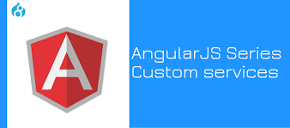
Angular js Services
Customs Services in AngularJS
We can create our own service by connecting it with a module in AngularJS. And to use it add it as a dependency while defining controller.
Image Source: https://www.valuebound.com/sites/default/files/styles/homepage_slider/public/AngularJS%20Series_Custom%20services_Cover%20image.jpg?itok=f7fAw20c
Notes:
Left (White Color space):
Title - Parent Topic
Subtitle - Subtopic 1
Body Text - Description in bullets
Right (Grey Color Space):
Body Text - Relevant image (with source)/code snippet
Put reference links in Speaker Notes
Reference:
https://www.tutorialspoint.com/internet_technologies/internet_overview.htm/

Slide 25
Angular js Http Request
Customs Services in AngularJS
AngularJS provides $http control which works as a service to read data from the server.
$http is an AngularJS service for reading data from remote servers.
Image Source: https://www.valuebound.com/sites/default/files/styles/homepage_slider/public/AngularJS%20Series_Custom%20services_Cover%20image.jpg?itok=f7fAw20c
Notes:
Left (White Color space):
Title - Parent Topic
Subtitle - Subtopic 1
Body Text - Description in bullets
Right (Grey Color Space):
Body Text - Relevant image (with source)/code snippet
Put reference links in Speaker Notes
Reference:
https://www.tutorialspoint.com/internet_technologies/internet_overview.htm/

Slide 26
Angular js Http Request
$http({
method: 'Method_Name',
url: '/someUrl'
}).then(function successCallback(response) {
//when the response is available, this callback will be called asynchronously
}, function errorCallback(response) {
// this method will called when server returns response with an error status.
});
Customs Services in AngularJS
The $http is a core AngularJS service that is used to communicate with the remote HTTP service via browser’s XMLHttpRequest object or via JSONP.
Syntax:
Notes:
Left (White Color space):
Title - Parent Topic
Subtitle - Subtopic 1
Body Text - Description in bullets
Right (Grey Color Space):
Body Text - Relevant image (with source)/code snippet
Put reference links in Speaker Notes
Reference:
https://www.tutorialspoint.com/internet_technologies/internet_overview.htm/

Slide 27
Angular js Http Request
$http({
method: 'Method_Name',
url: '/someUrl'
}).then(function successCallback(response) {
//when the response is available, this callback will be called asynchronously
}, function errorCallback(response) {
// this method will called when server returns response with an error status.
});
Methods
In the above example we used the .get shortcut method for $ajax service . There are also other shortcut methods.
$http.get
$http.post
$http.head
Notes:
Left (White Color space):
Title - Parent Topic
Subtitle - Subtopic 1
Body Text - Description in bullets
Right (Grey Color Space):
Body Text - Relevant image (with source)/code snippet
Put reference links in Speaker Notes
Reference:
https://www.tutorialspoint.com/internet_technologies/internet_overview.htm/

Slide 28
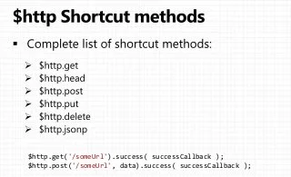
Angular js Http Request
Methods
$http.put
$http.delete
$http.patch
$http.jsonp
Image Source: https://image.slidesharecdn.com/02-httpresource-140216002719-phpapp01/85/angularjs-http-resource-services-6-320.jpg?cb=1392510554
Notes:
Left (White Color space):
Title - Parent Topic
Subtitle - Subtopic 1
Body Text - Description in bullets
Right (Grey Color Space):
Body Text - Relevant image (with source)/code snippet
Put reference links in Speaker Notes
Reference:
https://www.tutorialspoint.com/internet_technologies/internet_overview.htm/

Slide 29
Angular js Http Request
Property | Description
.config | The configuration object that was used to generate the request.
.status | Status number defining the HTTP status.
.data | The response body transformed with the transform functions.
.headers | Function to use to get header information.
.statusText | HTTP status text of the response.
Property
The response from the server is retrieved as an object and this object contains the following properties
Notes:
Left (White Color space):
Title - Parent Topic
Subtitle - Subtopic 1
Body Text - Description in bullets
Right (Grey Color Space):
Body Text - Relevant image (with source)/code snippet
Put reference links in Speaker Notes
Reference:
https://www.tutorialspoint.com/internet_technologies/internet_overview.htm/

Slide 30
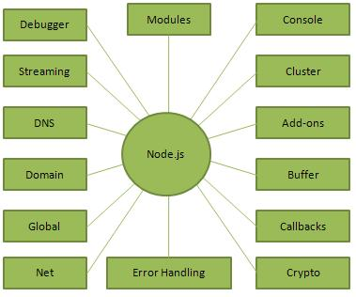
Node Introduction
What is Node.js?
Node.js is a server-side platform built on Google Chrome's JavaScript Engine (V8 Engine).
Node.js was developed by Ryan Dahl in 2009 and its latest version is v0.10.36.
Image Source: https://www.tutorialspoint.com/nodejs/images/nodejs_concepts.jpg
Notes:
Left (White Color space):
Title - Parent Topic
Subtitle - Subtopic 1
Body Text - Description in bullets
Right (Grey Color Space):
Body Text - Relevant image (with source)/code snippet
Put reference links in Speaker Notes
Reference:
https://www.tutorialspoint.com/internet_technologies/internet_overview.htm/

Slide 31
Node Introduction
What is Node.js?
Node.js is an open source, cross-platform runtime environment.
Node.js applications are written in JavaScript, and can be run within the Node.js runtime on OS X, Microsoft Windows, and Linux.
Node.js = Runtime Environment + JavaScript Library
Image Source: https://www.tutorialspoint.com/nodejs/images/nodejs_concepts.jpg
Notes:
Left (White Color space):
Title - Parent Topic
Subtitle - Subtopic 1
Body Text - Description in bullets
Right (Grey Color Space):
Body Text - Relevant image (with source)/code snippet
Put reference links in Speaker Notes
Reference:
https://www.tutorialspoint.com/internet_technologies/internet_overview.htm/

Slide 32
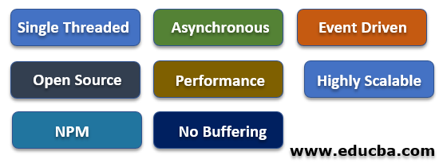
Node Introduction
Features of Node.js
Following are some of the important features that make Node.js the first choice of software architects.
Asynchronous and Event Driven
Very Fast
Single Threaded but Highly Scalable
No Buffering
License
Image Source: https://cdn.educba.com/academy/wp-content/uploads/2020/01/Features-of-Node.js-2.png
Notes:
Left (White Color space):
Title - Parent Topic
Subtitle - Subtopic 1
Body Text - Description in bullets
Right (Grey Color Space):
Body Text - Relevant image (with source)/code snippet
Put reference links in Speaker Notes
Reference:
https://www.tutorialspoint.com/internet_technologies/internet_overview.htm/

Slide 33
Node Introduction
Concepts
The following diagram depicts some important parts of Node.js which we will discuss in detail in the subsequent chapters.
Image Source: https://cdn.educba.com/academy/wp-content/uploads/2020/01/Features-of-Node.js-2.png
Notes:
Left (White Color space):
Title - Parent Topic
Subtitle - Subtopic 1
Body Text - Description in bullets
Right (Grey Color Space):
Body Text - Relevant image (with source)/code snippet
Put reference links in Speaker Notes
Reference:
https://www.tutorialspoint.com/internet_technologies/internet_overview.htm/

Slide 34
Node Introduction
HTML Tags and Attributes
The following diagram depicts some important parts of Node.js which we will discuss in detail in the subsequent chapters.
Image Sources: https://www.tutorialspoint.com/nodejs/images/nodejs_concepts.jpg
Notes:
This slide talks about the case if we have to divide a subtopic further.
Title Box - Parent Topic
Subtitle box - Sub Topic
Body Text - Subtopic divisions (Subtopics of subtopics)

Slide 35
Node Introduction
Where to Use Node.js?
Following are the areas where Node.js is proving itself as a perfect technology partner.
I/O bound Applications
Data Streaming Applications
Data Intensive Real-time Applications (DIRT)
JSON APIs based Applications
Single Page Applications
Image Sources: https://www.tutorialspoint.com/nodejs/images/nodejs_concepts.jpg
Notes:
This slide talks about the case if we have to divide a subtopic further.
Title Box - Parent Topic
Subtitle box - Sub Topic
Body Text - Subtopic divisions (Subtopics of subtopics)

Slide 36
Node Introduction
Where Not to Use Node.js?
It is not advisable to use Node.js for CPU intensive applications.
Image Sources: https://www.tutorialspoint.com/nodejs/images/nodejs_concepts.jpg
Notes:
This slide talks about the case if we have to divide a subtopic further.
Title Box - Parent Topic
Subtitle box - Sub Topic
Body Text - Subtopic divisions (Subtopics of subtopics)

Slide 37
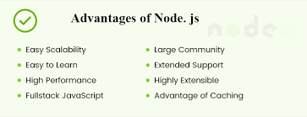
Node Introduction
Advantages of NodeJS:
Easy Scalability
Real-time web apps
Fast Suite
Easy to learn and code
Advantage of Caching
Image Sources: https://www.vervelogic.com/blog/wp-content/uploads/2020/03/Advantage-of-nodejs.png
Notes:
This slide talks about the case if we have to divide a subtopic further.
Title Box - Parent Topic
Subtitle box - Sub Topic
Body Text - Subtopic divisions (Subtopics of subtopics)

Slide 38
Node Introduction
Advantages of NodeJS:
Data Streaming
Hosting
Corporate Support
Image Sources: https://www.vervelogic.com/blog/wp-content/uploads/2020/03/Advantage-of-nodejs.png
Notes:
This slide talks about the case if we have to divide a subtopic further.
Title Box - Parent Topic
Subtitle box - Sub Topic
Body Text - Subtopic divisions (Subtopics of subtopics)

Slide 39
Node Introduction
Application of NodeJS
Real-Time Chats,
Complex Single-Page applications,
Real-time collaboration tools,
Streaming apps
JSON APIs based application
Image Sources: https://www.tutorialspoint.com/nodejs/images/nodejs_concepts.jpg
Notes:
This slide talks about the case if we have to divide a subtopic further.
Title Box - Parent Topic
Subtitle box - Sub Topic
Body Text - Subtopic divisions (Subtopics of subtopics)

Slide 40
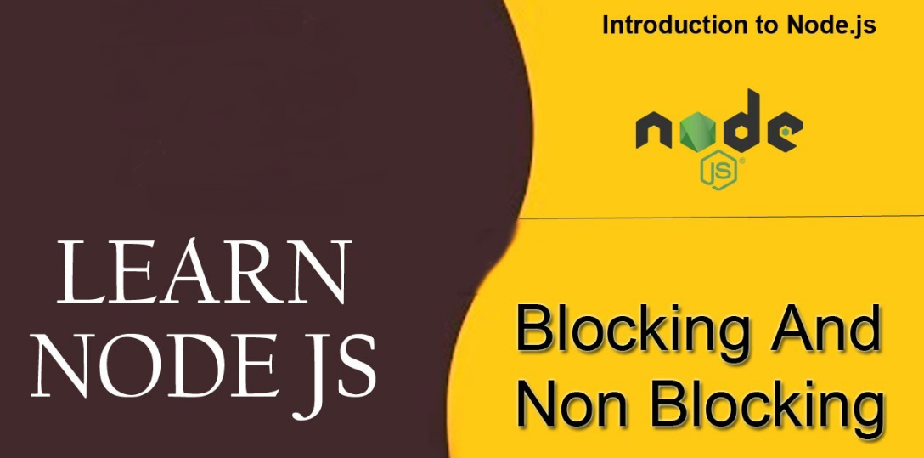
Blocking & Nonblocking code
Introduction
There are two types of execution of our code, synchronous and asynchronous.
The code is executed in sequence synchronously, and execution is awaited when the function is called.
In asynchronous execution, the line is not necessarily followed, and completion of the operation is not necessary.
Image Sources: https://bytearcher.com/articles/blocking-vs-non-blocking-in-node.js/process_state_diagram01.gif
Notes:
This slide talks about the case if we have to divide a subtopic further.
Title Box - Parent Topic
Subtitle box - Sub Topic
Body Text - Subtopic divisions (Subtopics of subtopics)

Slide 41
Blocking & Nonblocking code
Blocking
It refers to the blocking of further operation until the current operation finishes.
Blocking methods are executed synchronously.
Synchronously means that the program is executed line by line.
The program waits until the called function or the operation returns.
Image Sources: https://bytearcher.com/articles/blocking-vs-non-blocking-in-node.js/process_state_diagram01.gif
Notes:
This slide talks about the case if we have to divide a subtopic further.
Title Box - Parent Topic
Subtitle box - Sub Topic
Body Text - Subtopic divisions (Subtopics of subtopics)

Slide 42
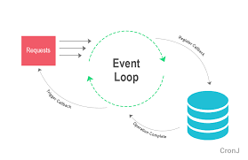
Blocking & Nonblocking code
Non-Blocking
It refers to the program that does not block the execution of further operations. Non-Blocking methods are executed asynchronously.
Asynchronously means that the program may not necessarily execute line by line.
The program calls the function and move to the next operation and does not wait for it to return.
Image Sources: https://bytearcher.com/articles/blocking-vs-non-blocking-in-node.js/process_state_diagram01.gif
Notes:
This slide talks about the case if we have to divide a subtopic further.
Title Box - Parent Topic
Subtitle box - Sub Topic
Body Text - Subtopic divisions (Subtopics of subtopics)

Slide 43
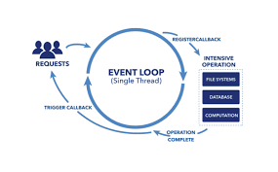
Blocking & Nonblocking code
Comparison between Blocking and Non-Blocking in Node.js
Non-blocking execution is usually faster if we compare blocking and non-blocking code in node.js, allowing concurrency.
It will enable the event loop to execute JavaScript callback functions after completing other operations.
Image Sources: https://bytearcher.com/articles/blocking-vs-non-blocking-in-node.js/process_state_diagram01.gif
Notes:
This slide talks about the case if we have to divide a subtopic further.
Title Box - Parent Topic
Subtitle box - Sub Topic
Body Text - Subtopic divisions (Subtopics of subtopics)

